Slide 1
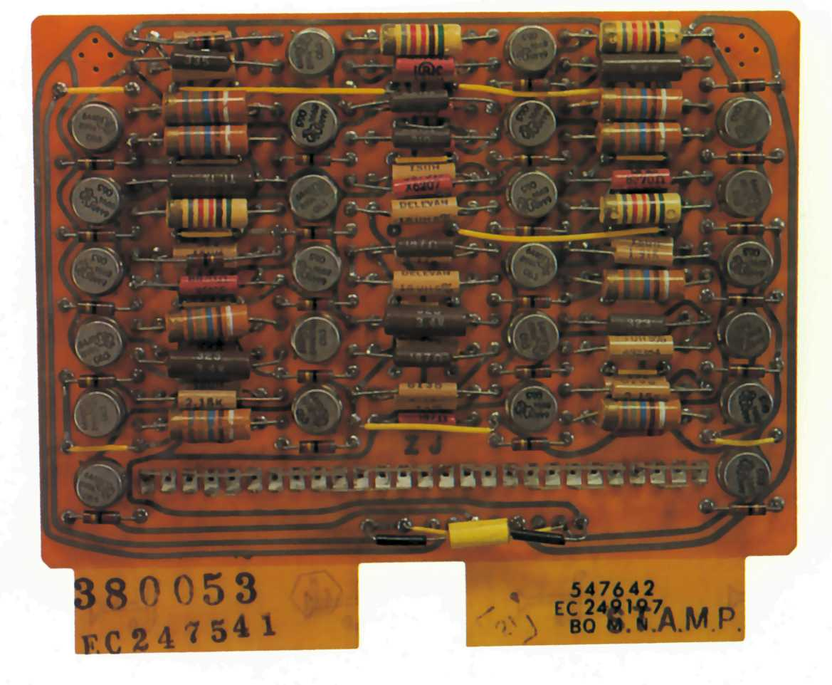
Modeling and Control of a Limited Degree of Freedom Helicopter
Dana Martin, EEGN517

Slide 2
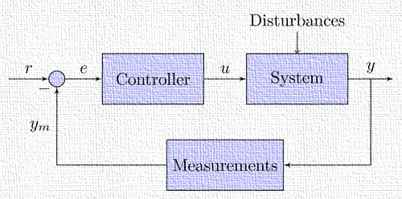
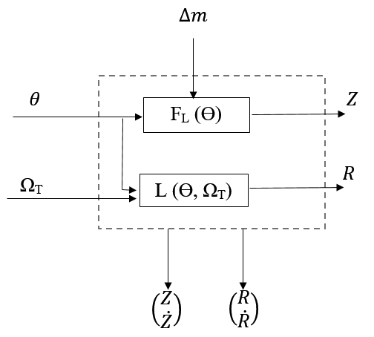
Block Diagram Representation
Advanced Control Theory Final Project
EEGN/EGGN517

Slide 3
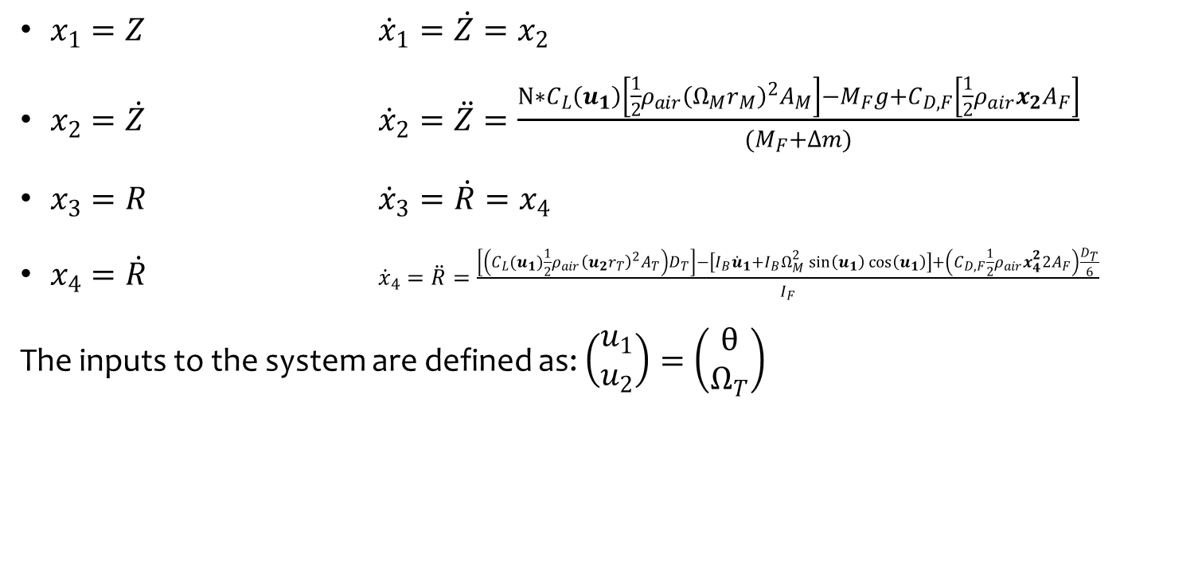
State Space Representation
Advanced Control Theory Final Project
EEGN/EGGN517
$x_{1}=Z$ ${\dot{x}}_{1}=\dot{Z}=x_{2}$
$x_{2}=\dot{Z}$ ${\dot{x}}_{2}=\ddot{Z}=\frac{{N∗C}_{L}\left(u_{1}\right)\left[\frac{1}{2}ρ_{air}{\left(Ω_{M}r_{M}\right)}^{2}A_{M}\right]−M_{F}g+C_{D,F}\left[\frac{1}{2}ρ_{air}x_{2}A_{F}\right]}{{(M}_{F}+∆m)}$
$x_{3}=R$ ${\dot{x}}_{3}=\dot{R}=x_{4}$
$x_{4}=\dot{R}$ ${\dot{x}}_{4}=\ddot{R}=\frac{\left[\left(C_{L}(u_{1})\frac{1}{2}ρ_{air}{\left(u_{2}r_{T}\right)}^{2}A_{T}\right)D_{T}\right]−\left[I_{B}{\dot{u}}_{1}+I_{B}Ω_{M}^{2}\sin\left(u_{1}\right)\cos\left(u_{1}\right)\right]+\left(C_{D,F}\frac{1}{2}ρ_{air}x_{4}^{2}{2A}_{F}\right)\frac{D_{T}}{6}}{I_{F}}$
The inputs to the system are defined as: $\left(\begin{matrix}u_{1} \\ u_{2}\end{matrix}\right)=\left(\begin{matrix}θ \\ Ω_{T}\end{matrix}\right)$

Slide 4
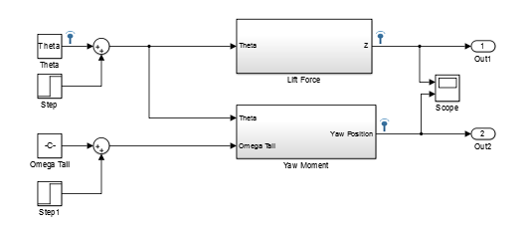
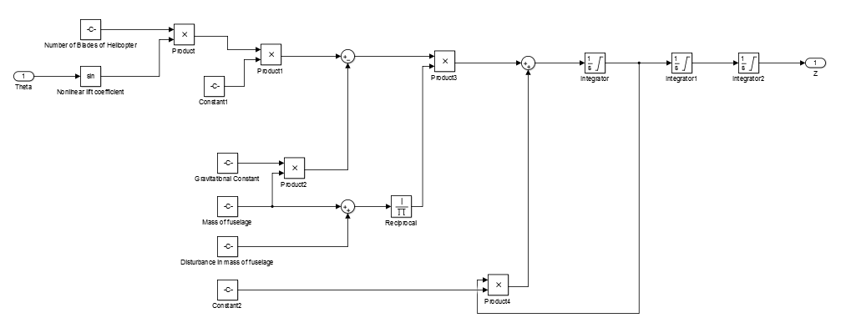
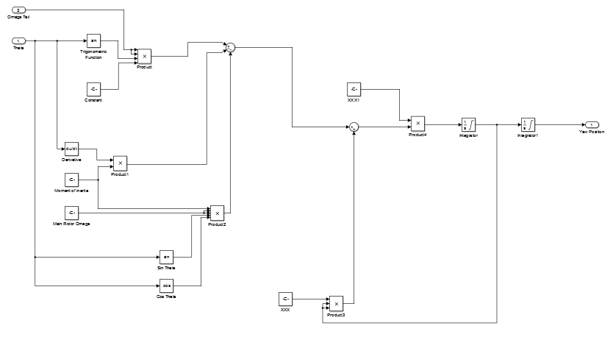
Non Linear System Simulation in Simulink
Advanced Control Theory Final Project
EEGN/EGGN517

Slide 5
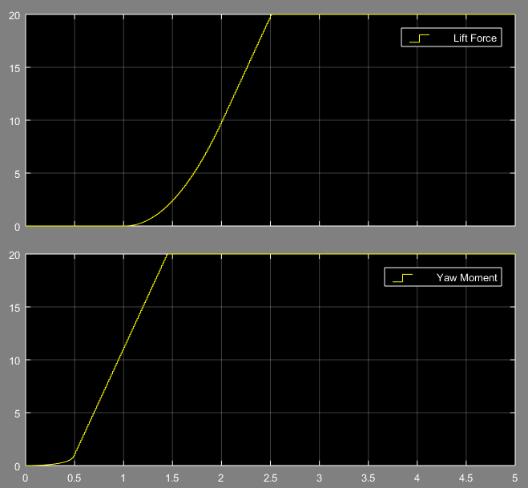
BIBO Stable?
Advanced Control Theory Final Project
EEGN/EGGN517
The BIBO stability of the system was tested using a step input and the resulting output was observed
As can be seen from the figure to the left, the system is not inherently BIBO stable. While the output does saturate at a defined value this is only because of a saturation setting chosen in a Simulink block.

Slide 6
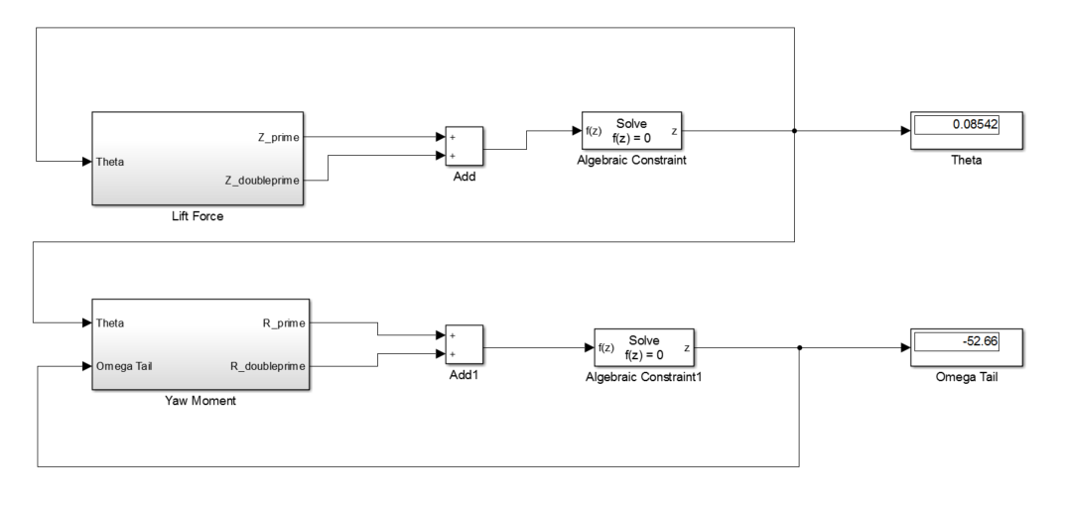
Linearization
Advanced Control Theory Final Project
EEGN/EGGN517
For a helicopter in hover given vertical and yaw DOF, the accelerations and velocities are zero.
Using Simulink, I was able to solve for steady-state operating values for the pitch angle of the main rotor and the angular velocity of the tail rotor using the block diagram shown to the right.

Slide 7
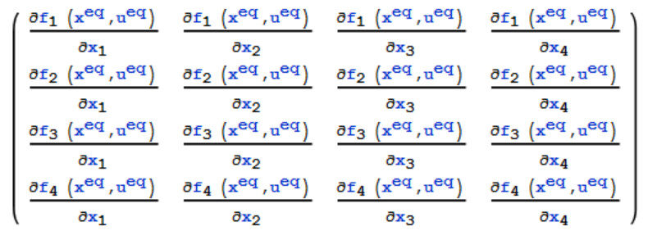
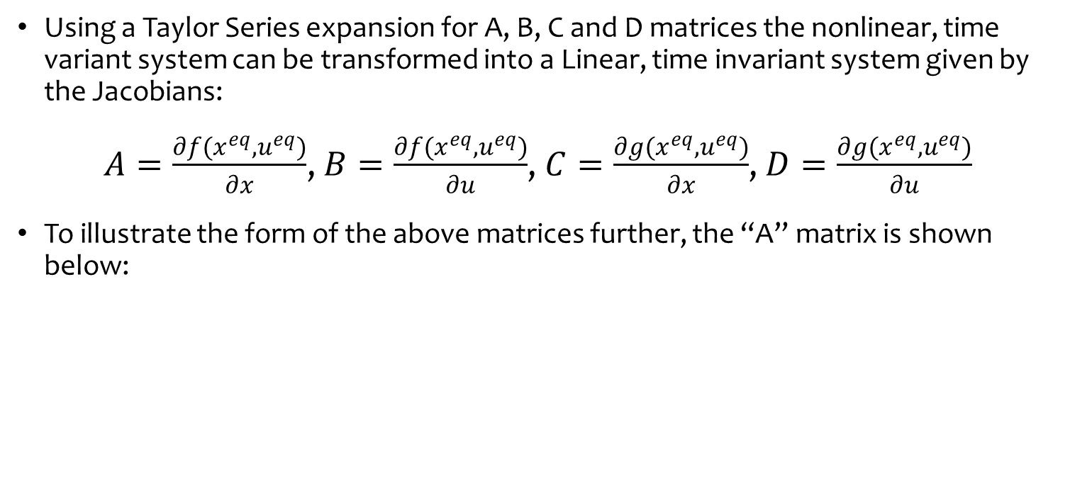
Linearization
Advanced Control Theory Final Project
EEGN/EGGN517
Using a Taylor Series expansion for A, B, C and D matrices the nonlinear, time variant system can be transformed into a Linear, time invariant system given by the Jacobians:
$A=\frac{∂f(x^{eq},u^{eq})}{∂x}$, $B=\frac{∂f(x^{eq},u^{eq})}{∂u}$, $C=\frac{∂g(x^{eq},u^{eq})}{∂x}$, $D=\frac{∂g(x^{eq},u^{eq})}{∂u}$
To illustrate the form of the above matrices further, the “A” matrix is shown below:

Slide 8
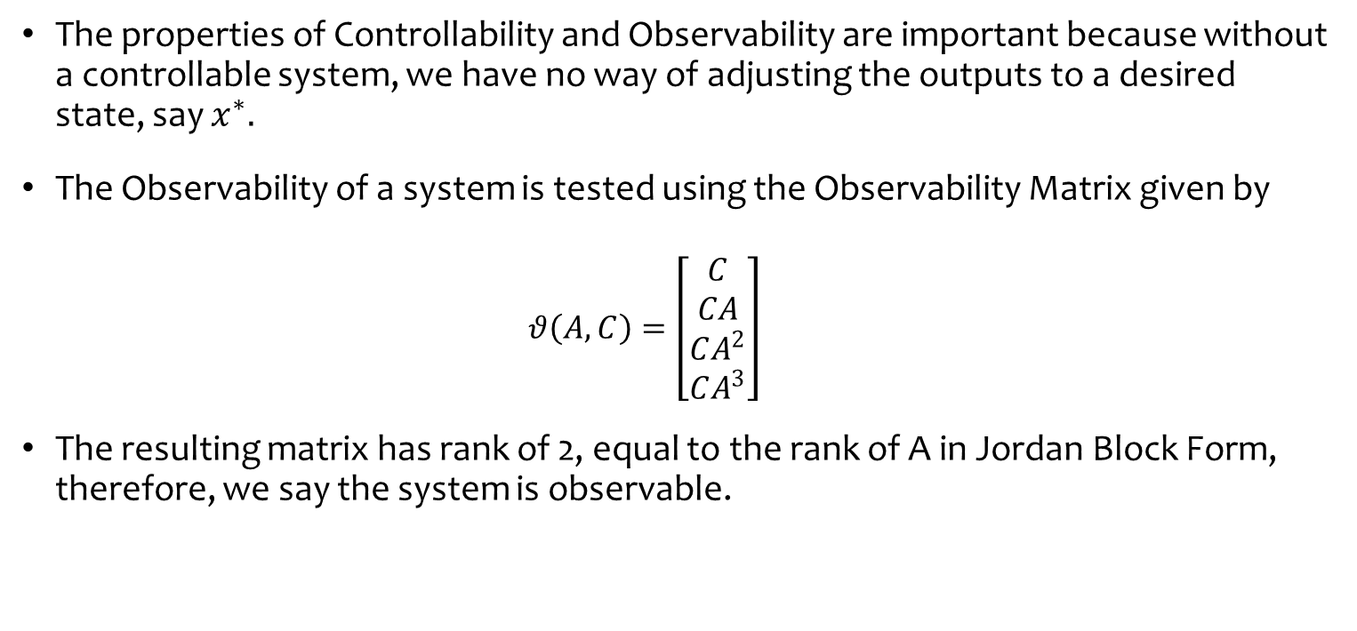
Observability
Advanced Control Theory Final Project
EEGN/EGGN517
The properties of Controllability and Observability are important because without a controllable system, we have no way of adjusting the outputs to a desired state, say $x^{∗}.$
The Observability of a system is tested using the Observability Matrix given by
$$θ\left(A,C\right)=\left[\begin{aligned}C \\ CA \\ CA^{2} \\ CA^{3}\end{aligned}\right]$$
The resulting matrix has rank of 2, equal to the rank of A in Jordan Block Form, therefore, we say the system is observable.

Slide 9
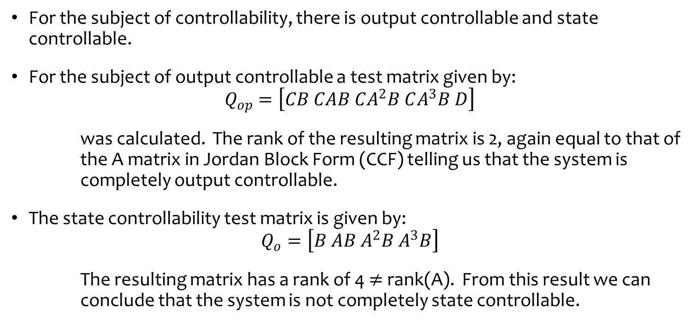
Controllability
Advanced Control Theory Final Project
EEGN/EGGN517
For the subject of controllability, there is output controllable and state controllable.
For the subject of output controllable a test matrix given by:
$$Q_{op}=\left[CB CAB CA^{2}B CA^{3}B D\right]$$
was calculated. The rank of the resulting matrix is 2, again equal to that of the A matrix in Jordan Block Form (CCF) telling us that the system is completely output controllable.
The state controllability test matrix is given by:
$$Q_{o}=\left[B AB A^{2}B A^{3}B\right]$$
The resulting matrix has a rank of 4 $≠$ rank(A). From this result we can conclude that the system is not completely state controllable.

Slide 10
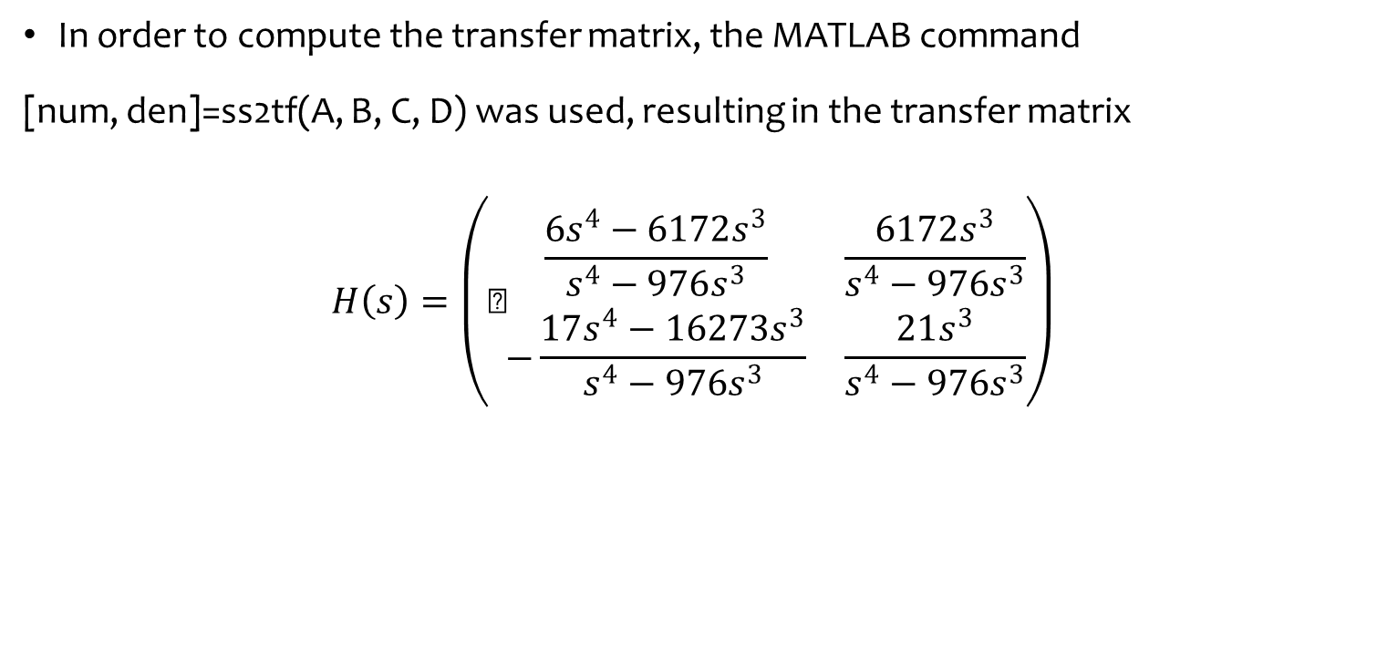
Transfer Matrix
Advanced Control Theory Final Project
EEGN/EGGN517
In order to compute the transfer matrix, the MATLAB command
[num, den]=ss2tf(A, B, C, D) was used, resulting in the transfer matrix
$$H\left(s\right)=\left(\text{⁠}\begin{matrix}\frac{6s^{4}−6172s^{3}}{s^{4}−976s^{3}} & \frac{6172s^{3}}{s^{4}−976s^{3}} \\ −\frac{17s^{4}−16273s^{3}}{s^{4}−976s^{3}} & \frac{21s^{3}}{s^{4}−976s^{3}}\end{matrix}\right)$$

Slide 11
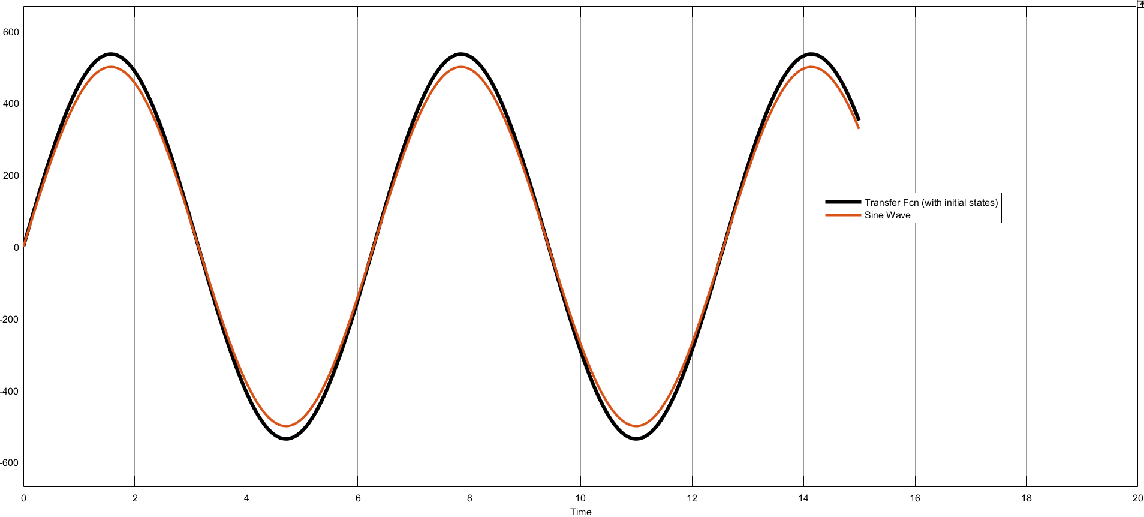
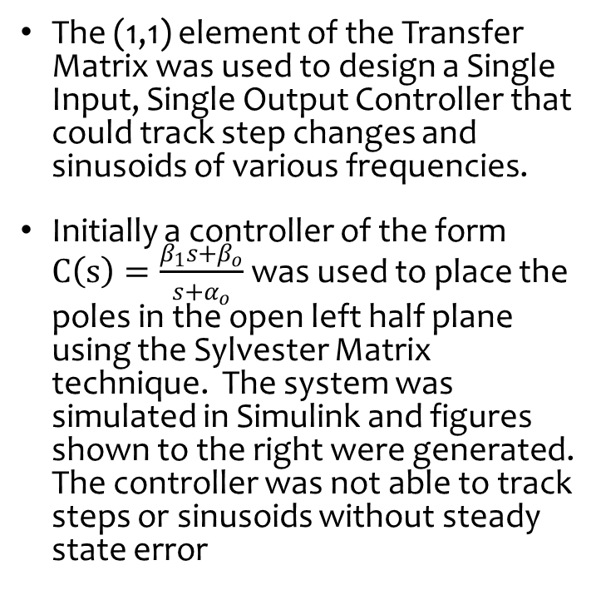
SISO Control
Advanced Control Theory Final Project
EEGN/EGGN517
The (1,1) element of the Transfer Matrix was used to design a Single Input, Single Output Controller that could track step changes and sinusoids of various frequencies.
Initially a controller of the form $C\left(s\right)=\frac{β_{1}s+β_{o}}{s{+α}_{o}}$ was used to place the poles in the open left half plane using the Sylvester Matrix technique. The system was simulated in Simulink and figures shown to the right were generated. The controller was not able to track steps or sinusoids without steady state error

Slide 12
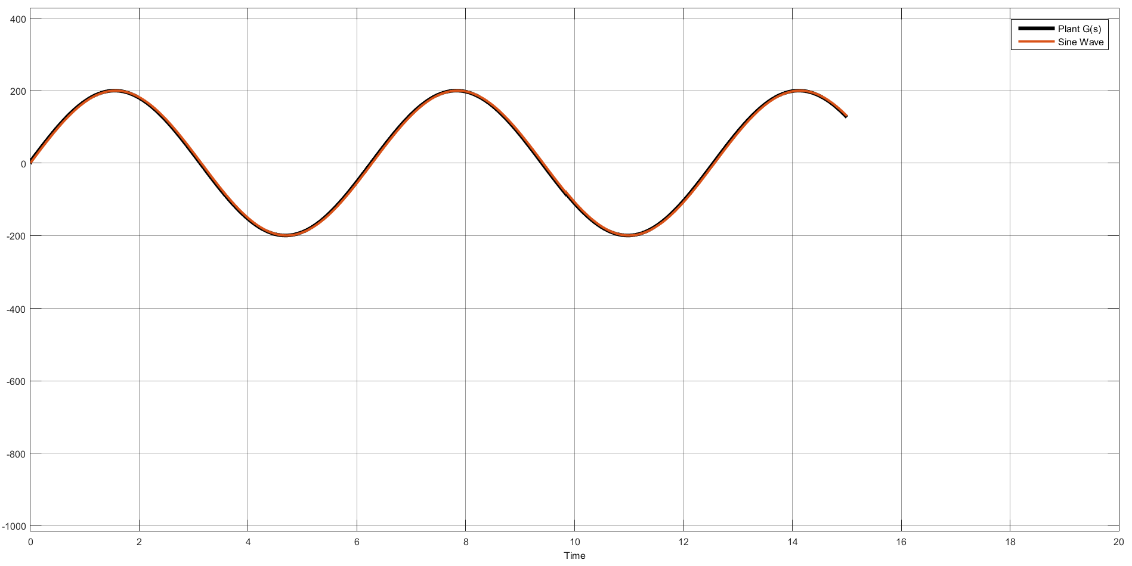
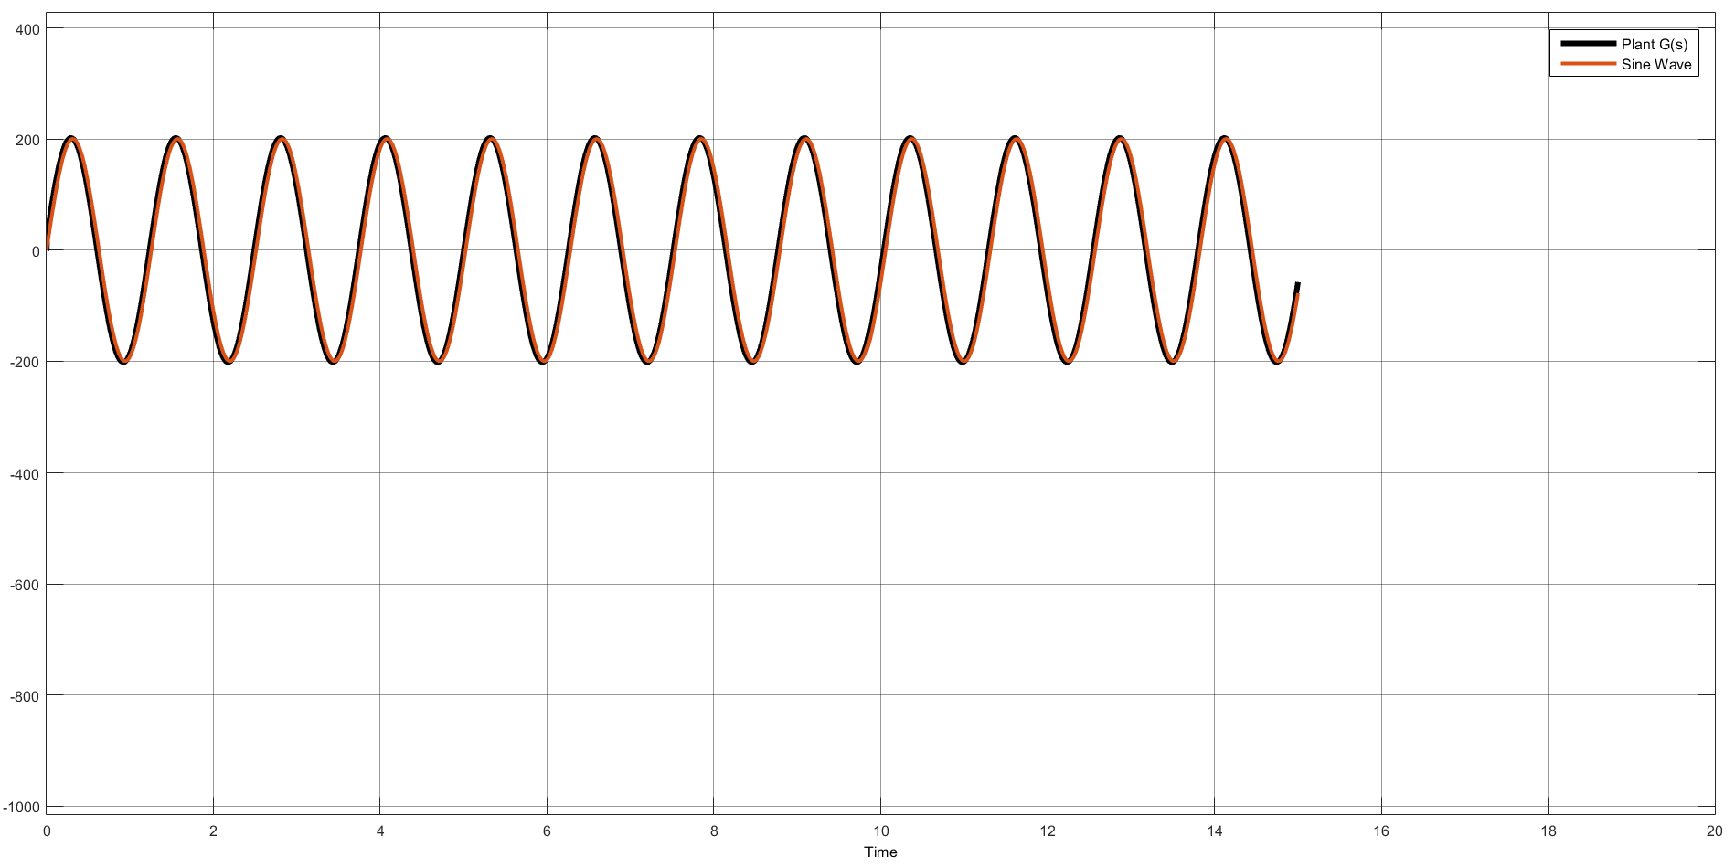
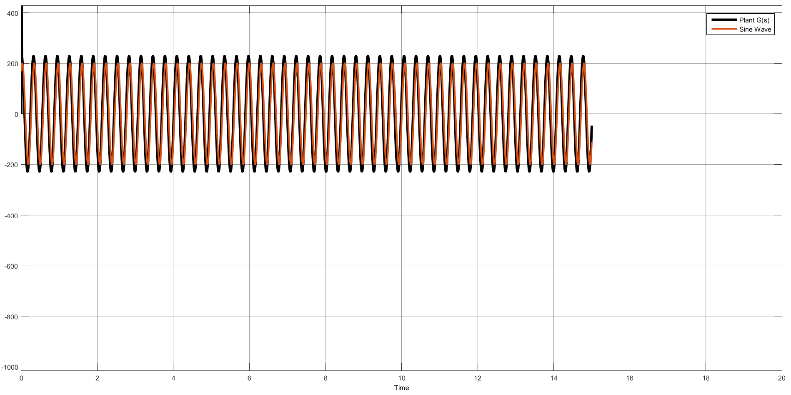
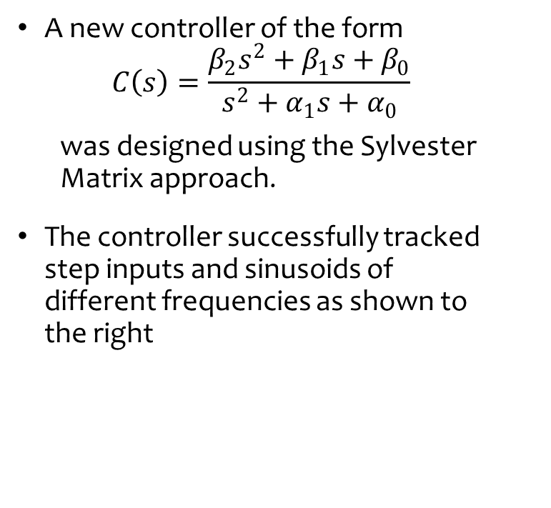
SISO Control
Advanced Control Theory Final Project
EEGN/EGGN517
A new controller of the form
$$C\left(s\right)=\frac{β_{2}s^{2}+β_{1}s+β_{0}}{s^{2}+α_{1}s+α_{0}}$$
was designed using the Sylvester Matrix approach.
The controller successfully tracked step inputs and sinusoids of different frequencies as shown to the right

Slide 13

MIMO Control
Advanced Control Theory Final Project
EEGN/EGGN517
A state controller was designed using the Linear Quadratic Regulator (LQR) technique. This technique uses the control law $u=−Kx$ to minimize the cost function
$$J=\int_{t_{o}}^{t_{f}}{\left(x^{′}Qx+u^{′}Ru+2∗x^{′}Nu\right)dt}$$

Slide 14
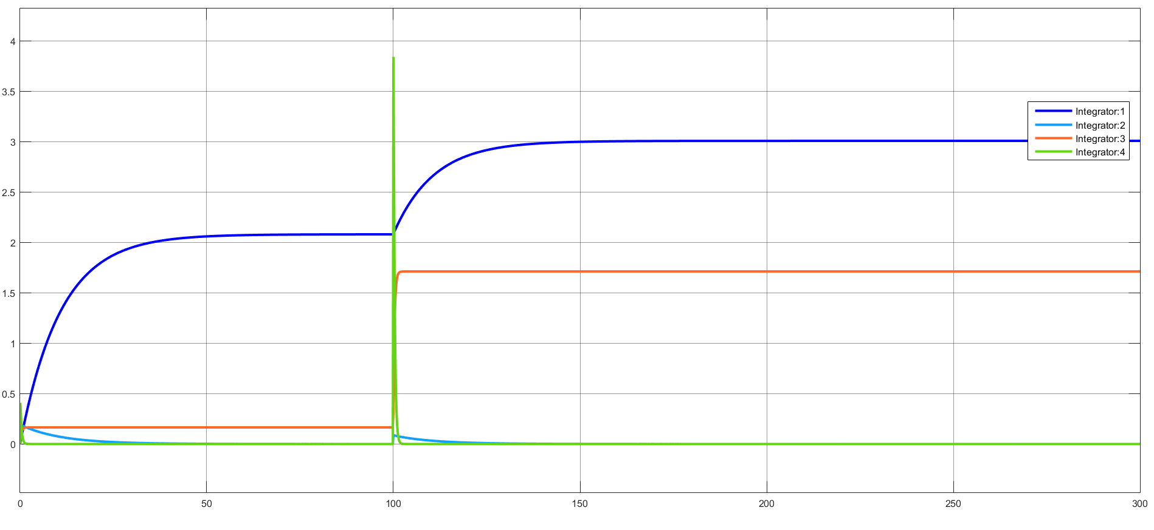
MIMO State Controller
Advanced Control Theory Final Project
EEGN/EGGN517

Slide 15
Advanced Control Theory Final Project
EEGN/EGGN517
Positives
I have 4 states!
Two of the states are zero, two of the states maintain positive values.
The two zero states maintain zero when hit with a step change
Negatives
I think the states being output are the incorrect states, meaning I have constructed the C matrix incorrectly
Two of the states are not linearized about the defined values
The states do not “track” the step, but instead they respond accordingly

Slide 16
Challenge Activity
Advanced Control Theory Final Project
EEGN/EGGN517
I plan to test my state space controller on a nonlinear plant.

